Slide 1
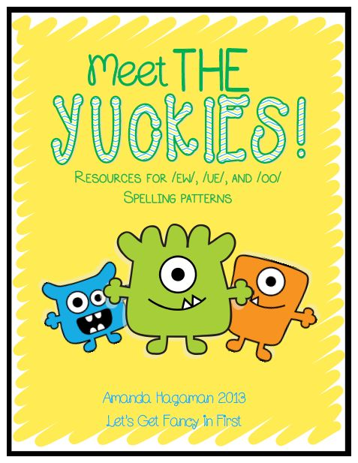

Slide 2
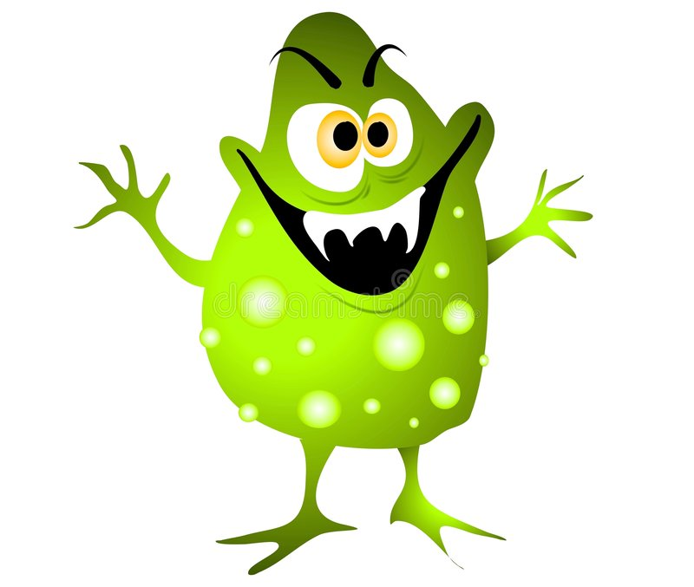
ou

Slide 3
soup

Slide 4
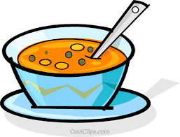

Slide 5
you

Slide 7
ew

Slide 8
new

Slide 10
grew

Slide 12
blew

Slide 13
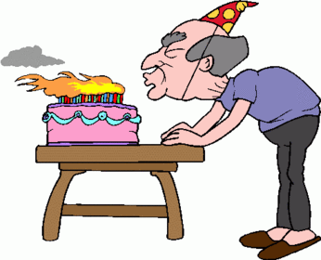

Slide 14
oo

Slide 15
zoo

Slide 16
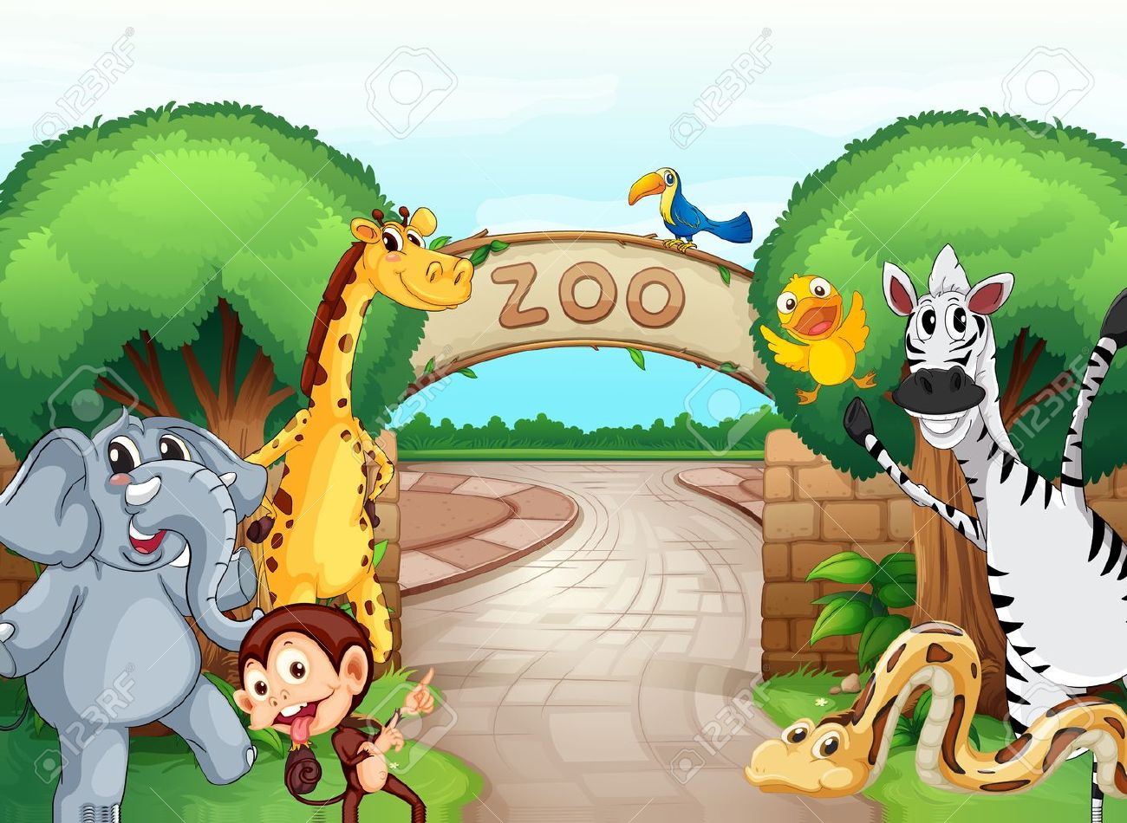

Slide 17
soon

Slide 19
boot

Slide 20
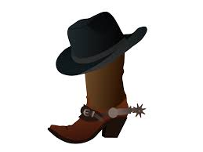

Slide 21
noon

Slide 22
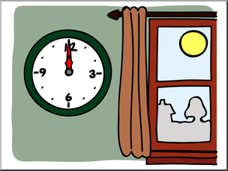

Slide 23
too

Slide 25
moon

Slide 26
